Slide 1

Prediction of genesis to decay route of wind storm
Under the Guidance of
Guide Name:Ms. M. L. Prasanthi
Designation :Associate Professor
Team:
16WH1A1213 – V. R. Tejaswi
16WH1A1239 – P. V. Niharika
16WH1A1241 – K. Meghana

Slide 2
Contents
Introduction
Problem Definition
Literature Survey
Data Set
Architecture Diagram
Module(s)
Input-Output
Plan of Action
References

Slide 3

Introduction
The world has witnessed an escalation of devastating wind storms over the last three decades.
Every year, the time between June 1 and November 30 signifies the North Atlantic Storm season.
During this period, the warm waters in the Atlantic give birth to tropical cyclones, and few of these tropical cyclones end up making landfall causing major casualties and loss of property.

Slide 4
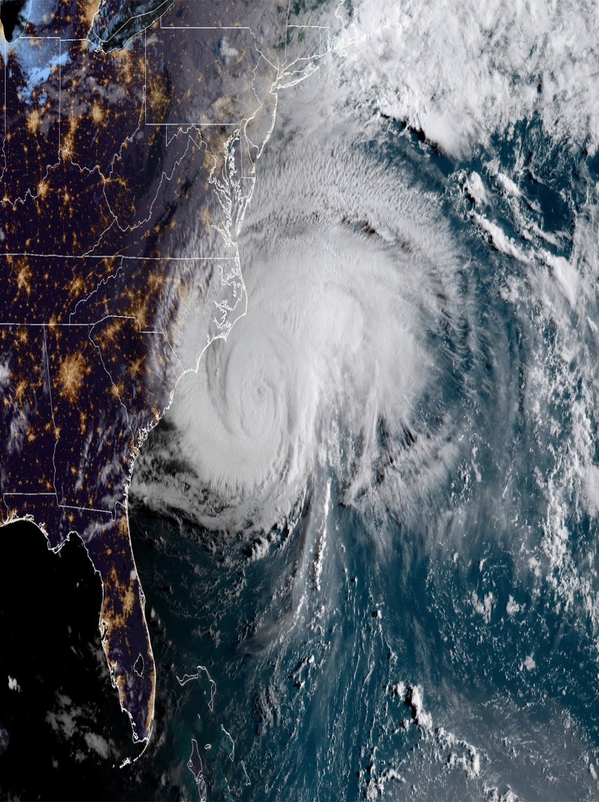
Problem Definition
Prediction of genesis to decay route of wind storm is a model which helps in predicting the path or route of a wind storm.
The accuracy of predicting their trajectory paths is critical to reduce economic loss and save human lives.

Slide 5
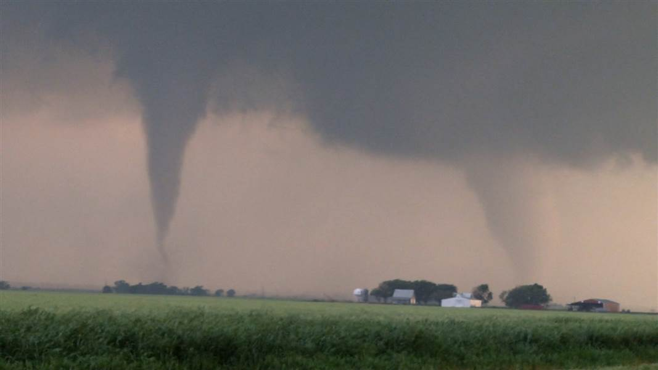
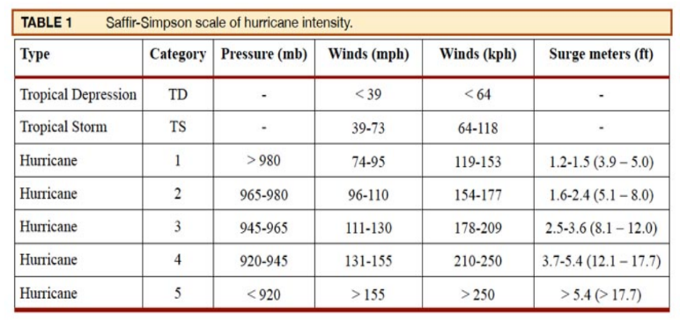
Literature Survey
Major Wind storms occur from Atlantic and Pacific ocean.

Slide 6
Architecture Diagram
Data Preprocessing
Plots and Figures
Path Plot
Position plot
Clustering
Markov Chains

Slide 7
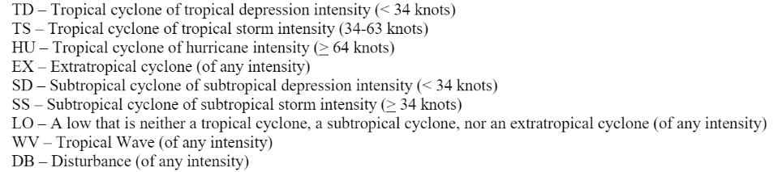
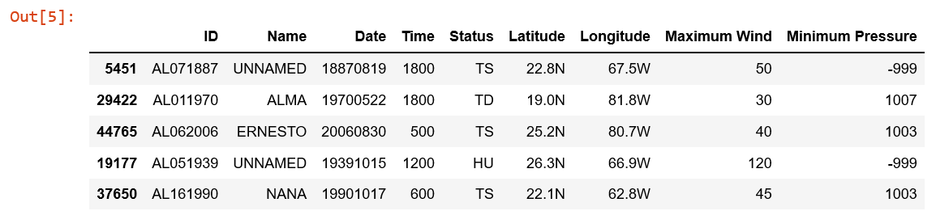
Data Set
Atlantic Wind Storm Data Set consists of 49106 Records.
It has ID, Name, Date, Time, Status(TS,HU,TD,EX,LO,SS,SD,WV,DB), Latitude, Longitude, Maximum Wind, Minimum Pressure.

Slide 8
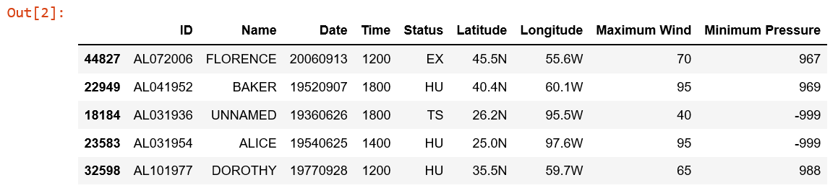
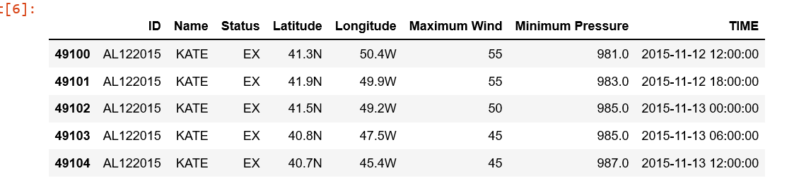
Data Preprocessing
Initial Data set
Data set After Formatting Date

Slide 9
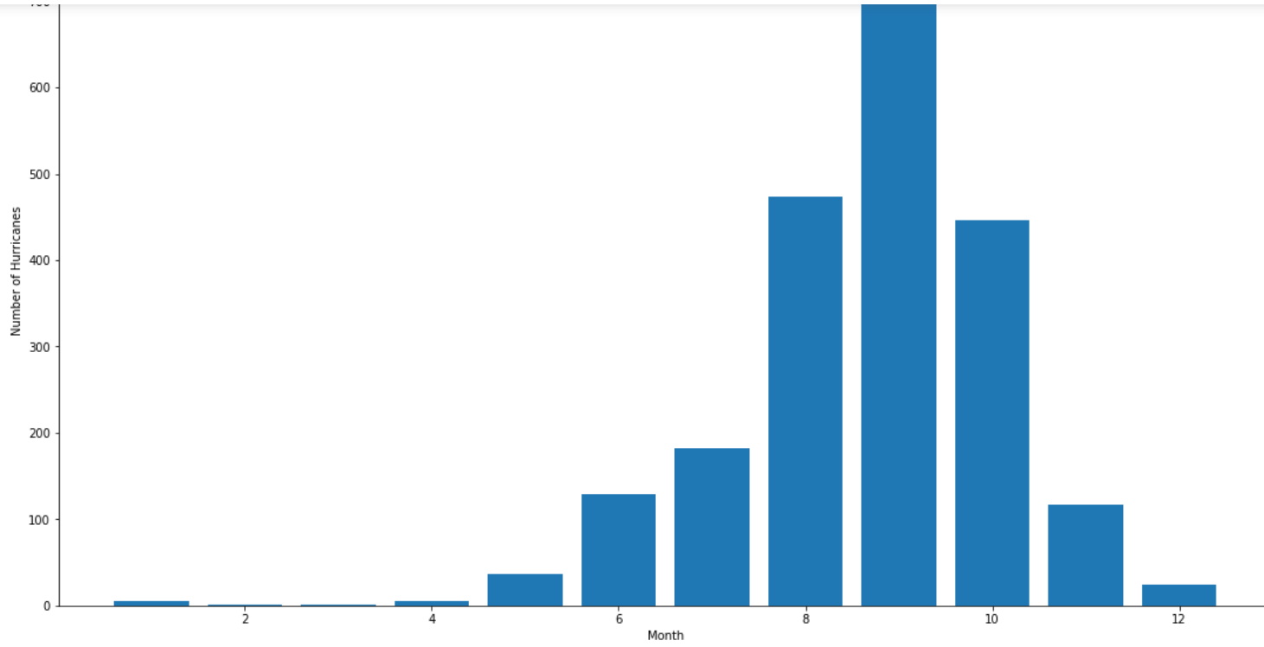
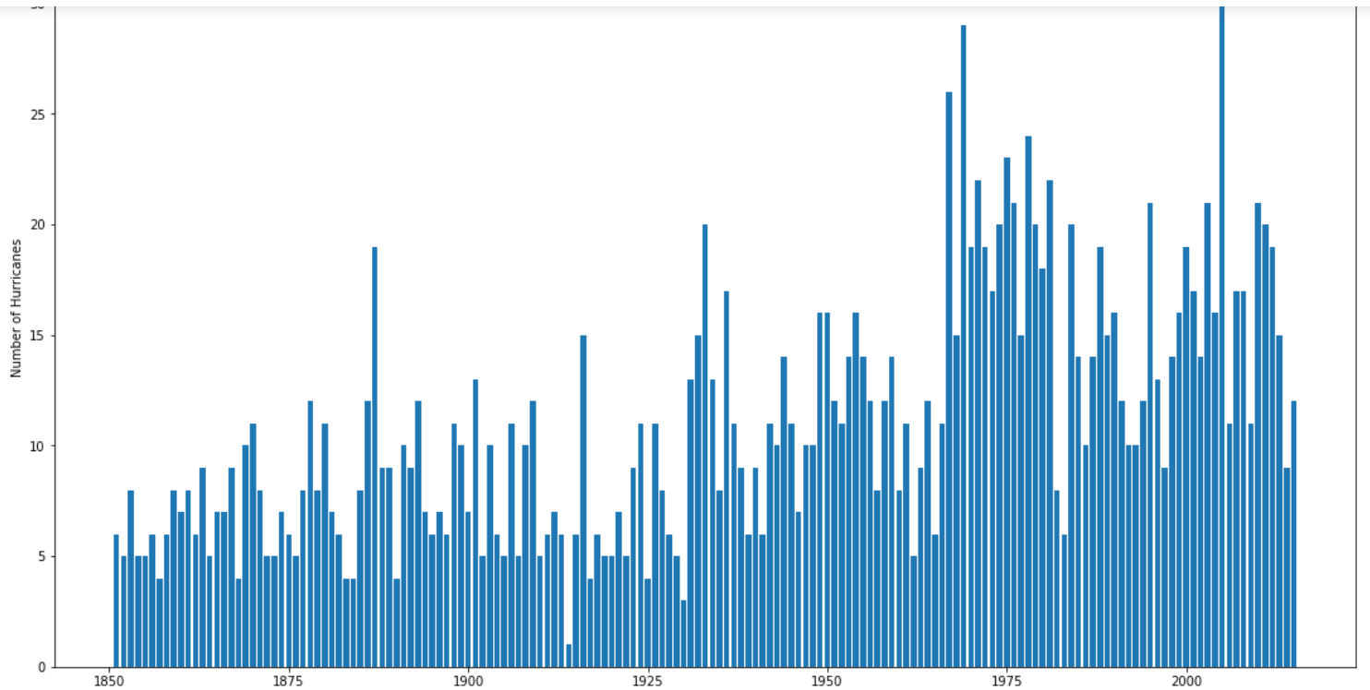
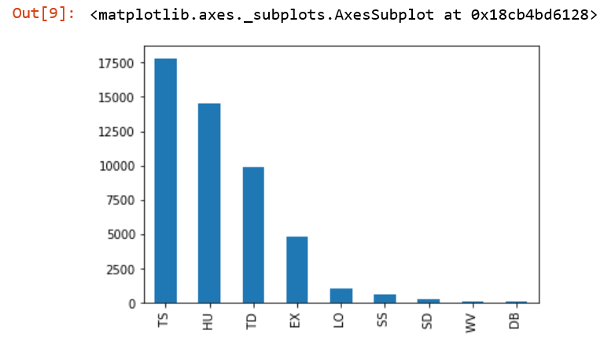
Data Analysis
Month
Year
Status

Slide 10
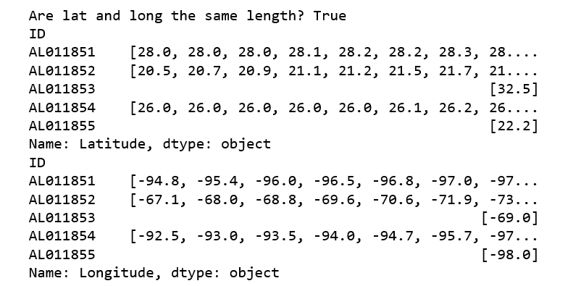
Latitude and Longitude

Slide 11
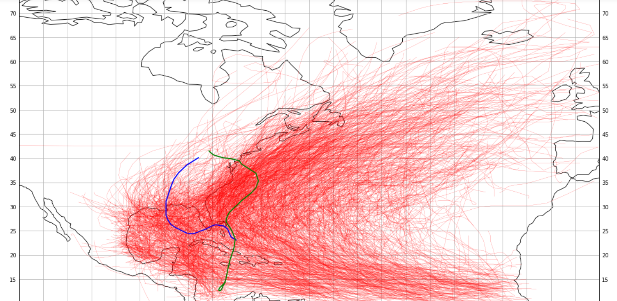
Path Plot
Blue - AL122005
Green - AL182012

Slide 12
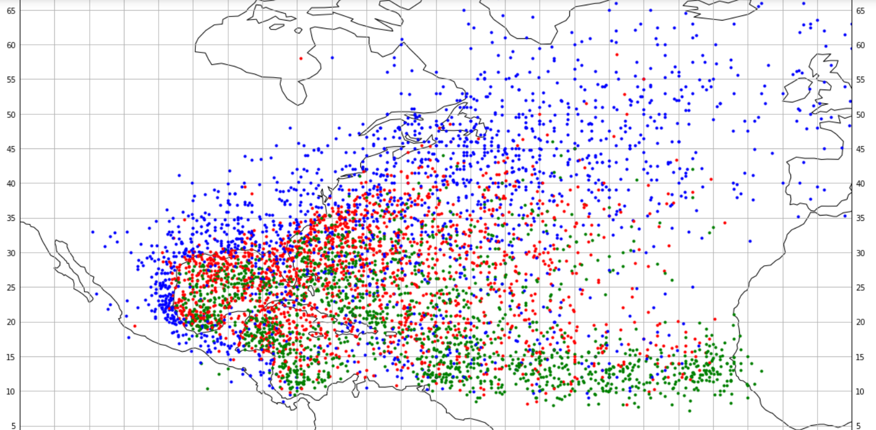
Position Plot
Blue - Genesis Points
Red - Mid Points
Green – Decay Points

Slide 13
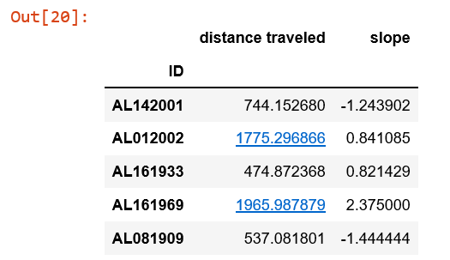
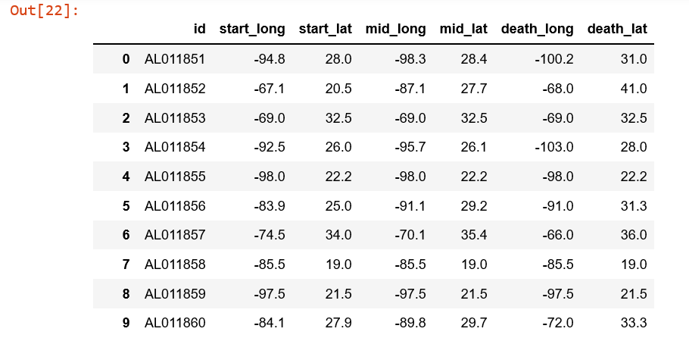
Start - mid -end

Slide 14
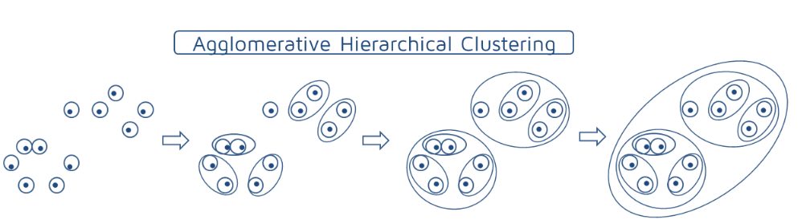
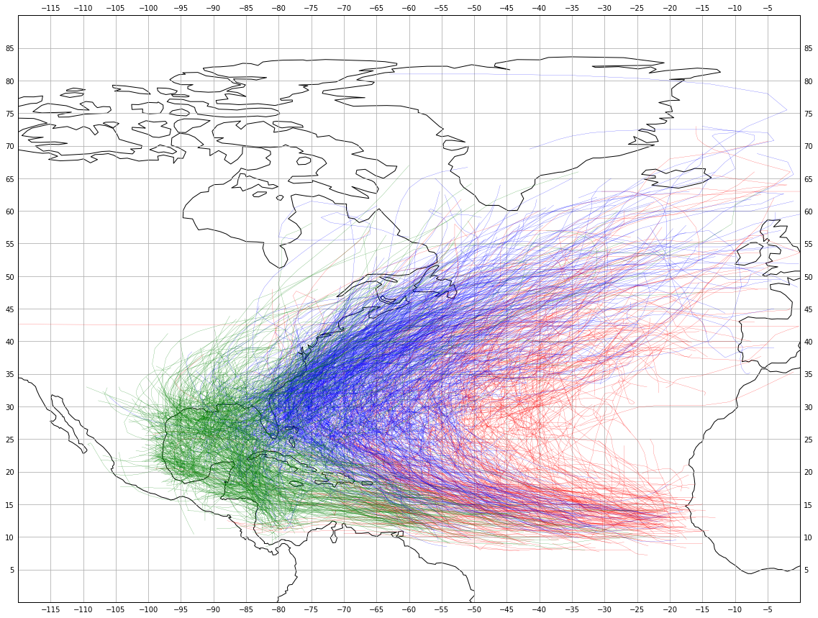
Clustering
Agglomerative Clustering
Bottom-up approach
The basic algorithm of Agglomerative is straight forward.
Compute the proximity matrix
Let each data point be a cluster
Repeat: Merge the two closest clusters and update the proximity matrix
Until only a single cluster remains

Slide 15
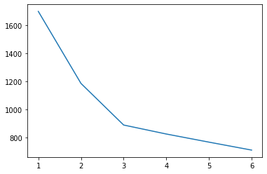
Elbow method
The elbow method is a heuristic method of interpretation and validation of consistency within cluster analysis designed to help find the appropriate number of clusters in a dataset.

Slide 16
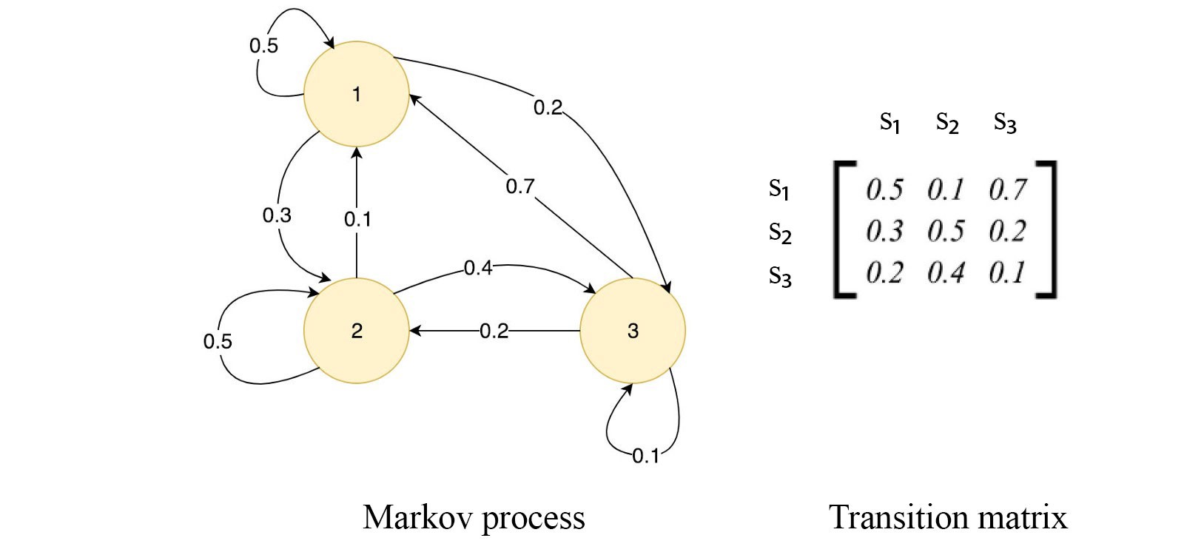
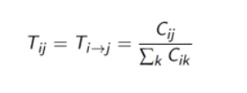
Markov Chain
Sequence of possible events in which the probability of each state depends only on the state attained in the previous state.
Transition Probabilities : The probability that an event will transition to a new state or stay the same.

Slide 17
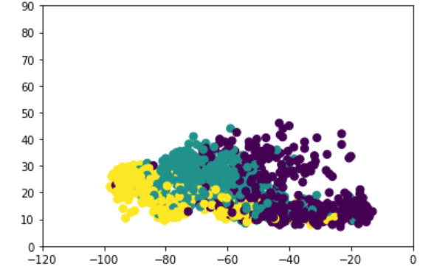
Modules
Data Analysis Module.
Clustering Module.
Path Prediction Module.

Slide 18
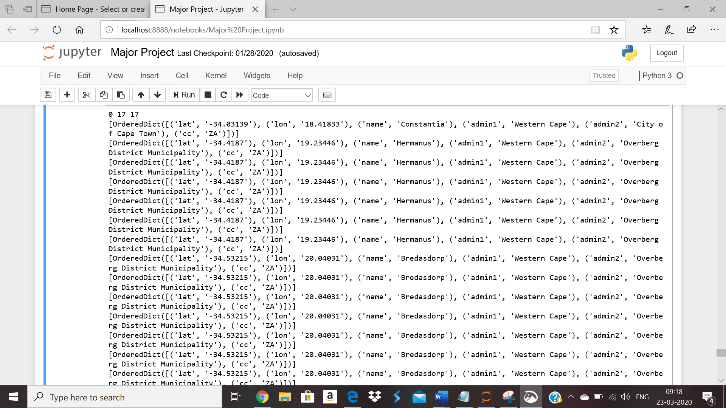
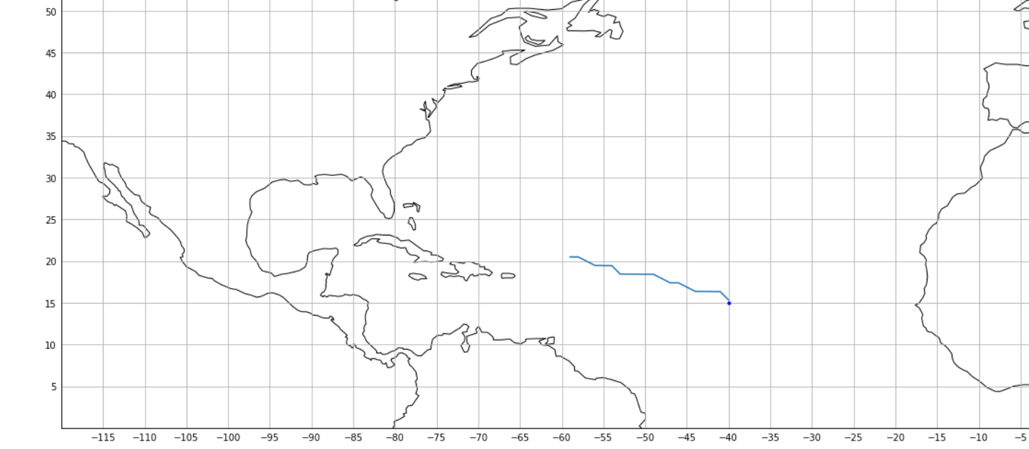
Input output

Slide 19
Action Plan
Module Information | Status | Time required to Complete
Literature Survey | Completed | -
Requirement Analysis | Completed | 1 Week
Design | Completed | 2 Weeks
Implementation | Completed | 4 Weeks
Documentation | Completed | 2 Weeks
Final Submission

Slide 20
References
Base Paper - Taylor S. Cox, Calvin S.H. Hoi, Carson K. Leung*, and Caden R. Marofke “An Accurate Model for Hurricane Trajectory Prediction ” IEEE Paper 2019, Department of Computer Science, Winnipeg, MB, Canada.
-> https://ieeexplore.ieee.org/abstract/document/8377918
->https://www.almanac.com/content/hurricane-forecast-facts-and-common-questions
->https://nsidc.org/cryosphere/glossary/term/synoptic-hour
->https://scikit-learn.org/stable/modules/generated/sklearn.cluster.AgglomerativeClustering.html

